Slide 1
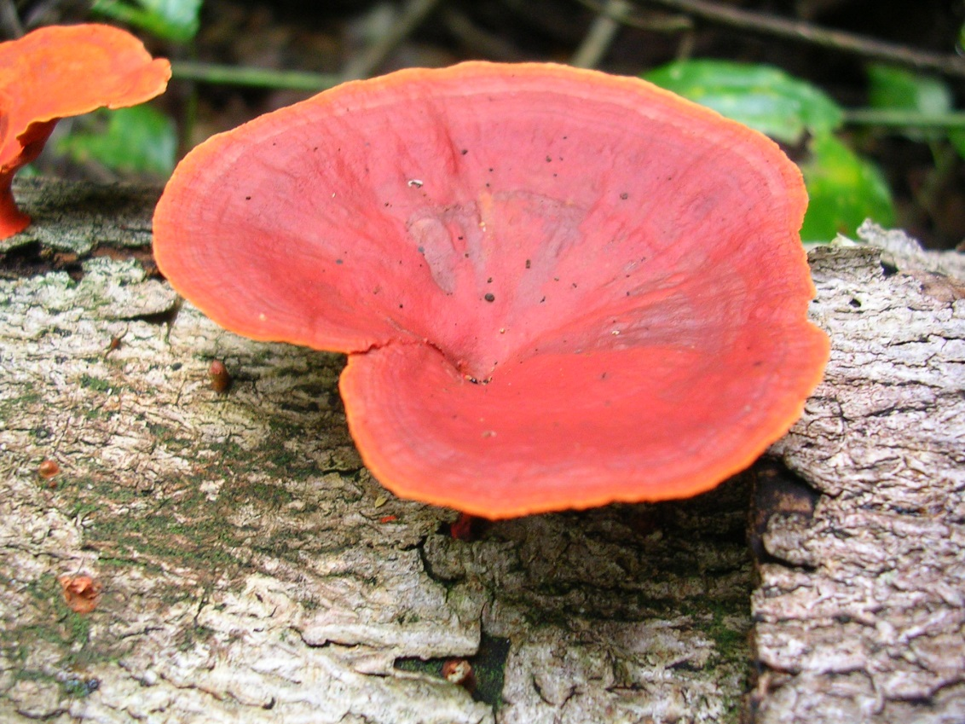
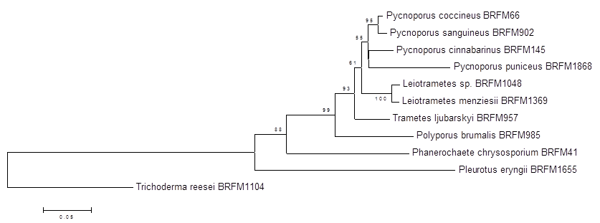
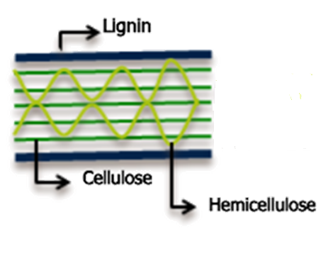
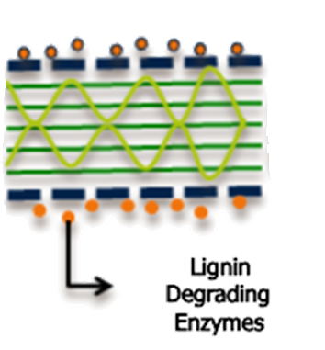
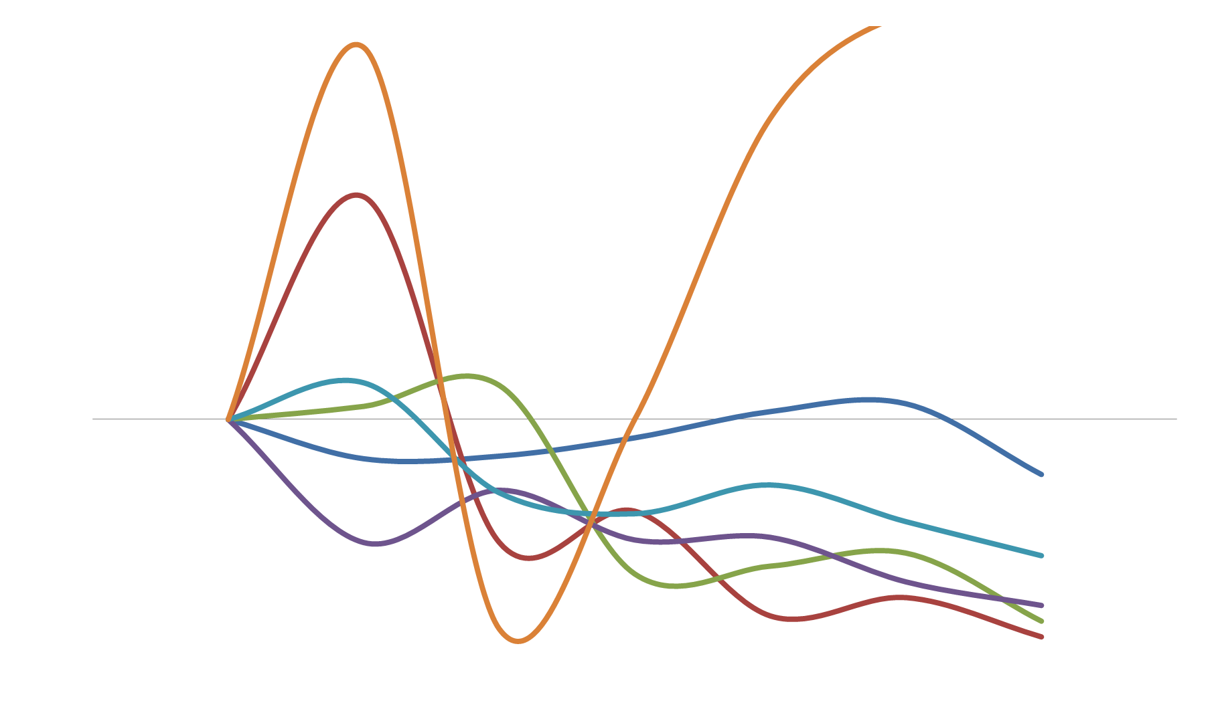
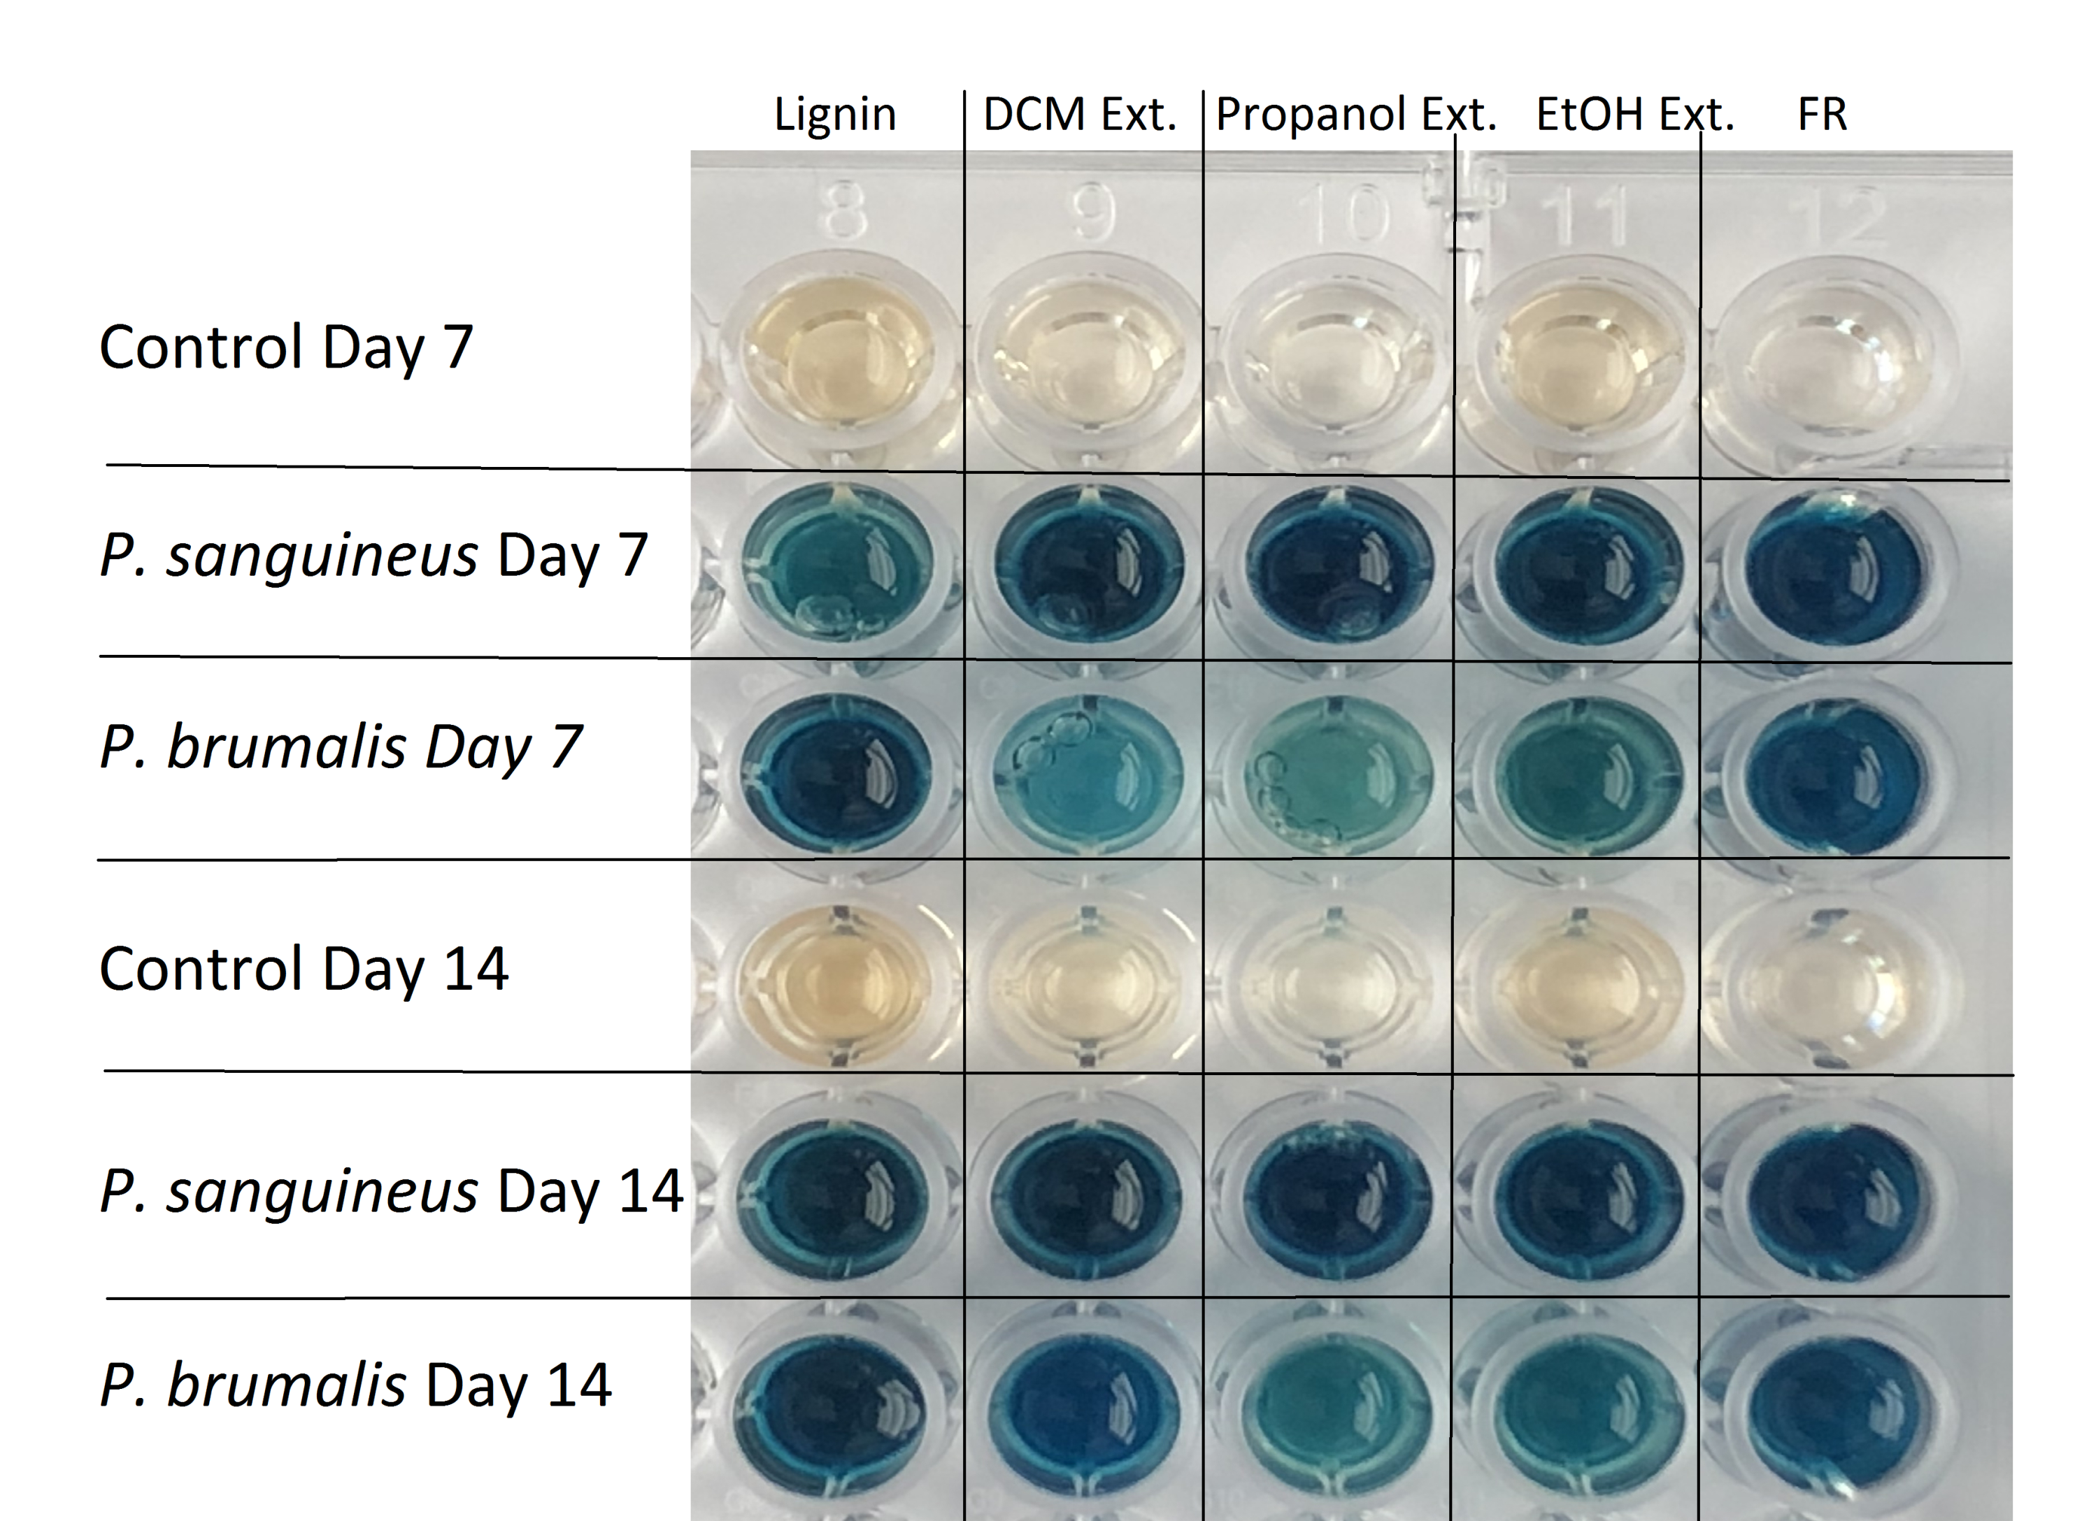
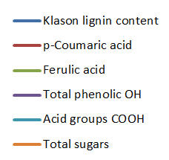
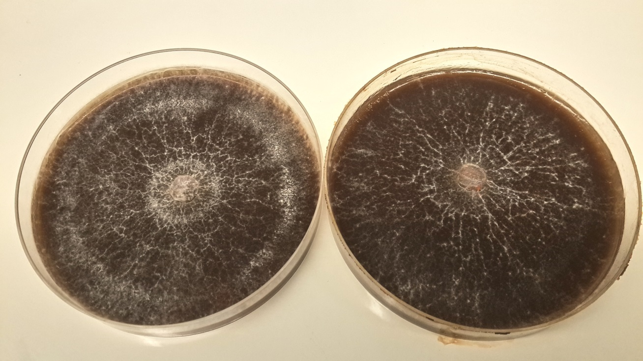
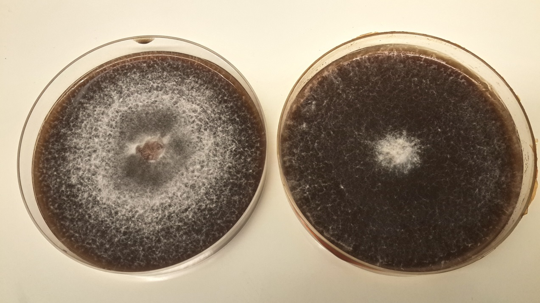
DETERMINING THE MECHANISMS OF FUNGAL GROWTH AND DECONSTRUCTION OF ALKALI LIGNINS
Marianne Daou¹, Clementina Farfan Soto¹, Florian Pion², Stephanie Baumberger², David Navarro¹, Sana Raouche¹ and Craig B.Faulds¹
¹Aix Marseille Université, INRA UMR1163 Biodiversité et Biotechnologie Fongiques (BBF), 13009 Marseille, France
² Institut Jean-Pierre Bourgin, INRA, AgroParisTech, CNRS, Université Paris-Saclay, 78000 Versailles, France
Lignocellulosic materials such as wood are made of three key components, cellulose, hemicellulose and lignins [1]. The lignocellulosic biomass constitutes the most abundant material on earth and its degradation is essential for carbon recycling [2]. Both its abundance and composition makes it also an important raw material for biotechnological applications. However, today only plant carbohydrates are efficiently exploited and lignins remain a major by-product due to their resistance to chemical and biological degradation. The valorization of lignins remains today challenging but highly required in the biorefineries concept to make the process more cost effective and help diversify produced materials. The enzymatic degradation of lignins was found to be a specific characteristic of wood-decaying filamentous fungi and especially the basidiomycetes. To be able to degrade lignins, fungi produce a wide variety of extracellular oxidases out of which some were widely characterized. However, the whole fungal enzymatic system is far more complex and new functional proteins need to be identified and studied. In addition, the mechanistic action and the pattern of expression of these enzymes varies between different fungi and new model organisms still need to be studied. This poster presents the screening of eleven fungal strains on unmodified and fractionated alkali lignins as sole carbon source.
Lignins
Degradation
Lignocellulose
Degradation
Alkali lignins were sequentially extracted in different solvents with increasing polarity and soluble parts were collected, rotary evaporated and dried to constant weight at 60°C then chemically analyzed.
Ethyl ether
extract
n-propanol
extract
Methanol
extract
Lignins
Dichloromethane
extract
Ethanol
extract
Final
residue
Liquid Cultures
Increase
Decrease
A
Solid Cultures
a.
b.
B
a.
b.
ABTS oxidation measured in the culture supernatants of Pycnoporus sanguineus and Polyporus brumalis
Acknowledgements
(A) P. sanguineus and (B) P. brumalis drowth on Lignins in presence (a) and absence (b) of glucose
Polyporus brumalis
a.
b.
c.
d.
e.
a. P. sanguineus on ethyl ether fraction; b. P. sanguineus on methanol fraction; c. P. brumalis on methanol fraction; d. L. menziesii on ethyl ether fraction; e. P. eryngii on dichloromethane fraction
Pycnoporus sanguineus
Filamentous fungi have naturally developed efficient mechanisms for the modification of lignins that if seen from a biotechnological perspective can significantly move forward lignins industry. This work shows how fungi behave differently in the presence of lignins suggesting different degradation mechanisms of this substrate. The key players behind lignins modification, fungal enzymes, were determined via proteomic analysis. The content of the secretomes varied widely between the studied strains and included not only known ligninocellulolytic enzymes but also unknown proteins which role in lignins degradation still needs to be studied.
Leiotrametes menziesii
This work has received funding from the Bio Based Industries Joint Undertaking under the European Union’s Horizon 2020 research and innovation program under grant agreement No. 720303 Project ZELCOR
Trichoderma reesei
CAZyme distribution in secretomes after growth on lignins for 3 days
1. Higuchi (1997) Springer Verlag, London; 2. Martinez et al. (2005) International Microbiology, 8: 195-204

